Slide 1
DSA (Digital Signature Algorithm)
Reporter：Dongxue shu

Slide 2
What Is DSA (Digital Signature Algorithm)?
The Digital Signature Algorithm (DSA) is a Federal Information Processing Standard for digital signatures.
Key generation, Key generation has two phases. The first phase is a choice of algorithm parameters which may be shared between different users of the system, while the second phase computes public and private keys for a single user.

Slide 3
DSA
Per-user keys:
Given a set of parameters, the second phase computes private and public keys for a single user:
Choose a secret key x by some random method, where 0 < x < q.
Calculate the public key y = gx mod p.
There exist efficient algorithms for computing the modular exponentiations h(p − 1)/q mod p and gx mod p, such as exponentiation by squaring.

Slide 4
DSA
Let H be the hashing function and m the message
Generate a random per-message value where 1 < k < q
Calculate r = ( g k mod p ) mod q
In the unlikely case that r = 0, start again with a different random k
Calculate s = k − 1 ( H ( m ) + x r ) mod q
In the unlikely case that s = 0, start again with a different random k

Slide 5
DSA
Sensitivity
With DSA, the entropy, secrecy, and uniqueness of the random signature value k are critical. It is so critical that violating any one of those three requirements can reveal the entire private key to an attacker.[11] Using the same value twice (even while keeping k secret), using a predictable value, or leaking even a few bits of k in each of several signatures, is enough to reveal the private key x.[12]
This issue affects both DSA and ECDSA – in December 2010, a group calling itself fail0verflow announced recovery of the ECDSA private key used by Sony to sign software for the PlayStation 3 game console. The attack was made possible because Sony failed to generate a new random k for each signature.[13]
This issue can be prevented by deriving k deterministically from the private key and the message hash, as described by RFC 6979. This ensures that k is different for each H(m) and unpredictable for attackers who do not know the private key x.
In addition, malicious implementations of DSA and ECDSA can be created where k is chosen in order to subliminally leak information via signatures. For example an offline private key could be leaked from a perfect offline device that only released innocent-looking signatures.[14]

Slide 6
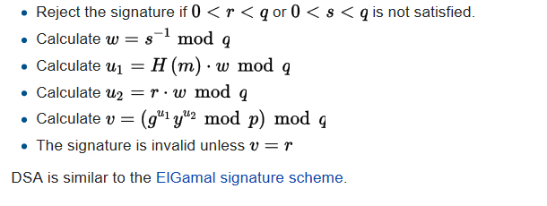
DSA
Reject the signature if or is not satisfied.
Verifying

